Slide 1

ETHICAL HACKING INTERNSHIP TASK-3
NAME-Swagatam Basu

Slide 2
Project Problem Statement(Task-3)
In this task you are completely free. http://testasp.vulnweb.com/ - This is the website. Explore the website and try to find vulnerabilities in the website and report it to us. You will be evaluated on your methods and report you submit. Don’t worry about evaluation, just report the vulnerabilities as you feel comfortable. Make sure your report matches this >> #751870 Reflected XSS in pubg.com (hackerone.com) You are expected to include the following in the final Report that you have to submit. 1) Proper Steps 2) ScreenShot 3) Video

Slide 3
Vulnerability Statistics
Critical
28%
Severe
13%
Moderate
6%
Low
25%

Slide 4
1. Cross-site Scripting
Cross-site scripting, which allows an attacker to execute a dynamic script (JavaScript, VBScript) in the context of the application.
Cross-site Scripting (Important) | Impact There are many different attacks that can be leveraged through the use of cross-site scripting, including: Hijacking user's active session. Mounting phishing attacks. Intercepting data and performing man-in-the-middle attacks. Remedy The issue occurs because the browser interprets the input as active HTML, JavaScript or VBScript. To avoid this, output should be encoded according to the output location and context. For example, if the output goes in to a JavaScript block within the HTML document, then output needs to be encoded accordingly. Encoding can get very complex, therefore it's strongly recommended to use an encoding library such as OWASP ESAPI and Microsoft Anti-cross-site scripting Remedy References Microsoft Anti-XSS Library OWASP XSS Prevention Cheat Sheet OWASP AntiSamy Java

Slide 5
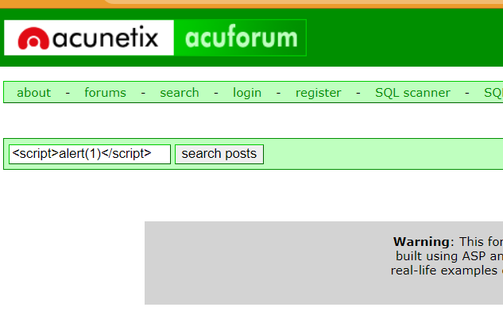
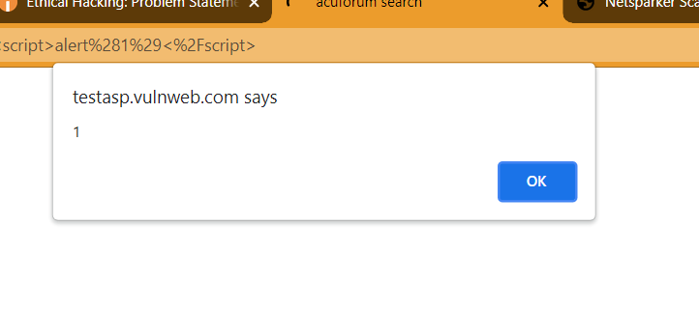
Proof of Concept (PoC)-(Cross Site Scripting)
Generated XSS exploit might not work due to browser XSS filtering. Please follow the guidelines below in order to disable XSS filtering for different browsers. Also note that;
XSS filtering is a feature that's enabled by default in some of the modern browsers. It should only be disabled temporarily to test exploits and should be reverted back if the browser is actively used other than testing purposes.
Even though browsers have certain checks to prevent Cross-site scripting attacks in practice there are a variety of ways to bypass this mechanism therefore a web application should not rely on this kind of client-side browser checks.

Slide 6
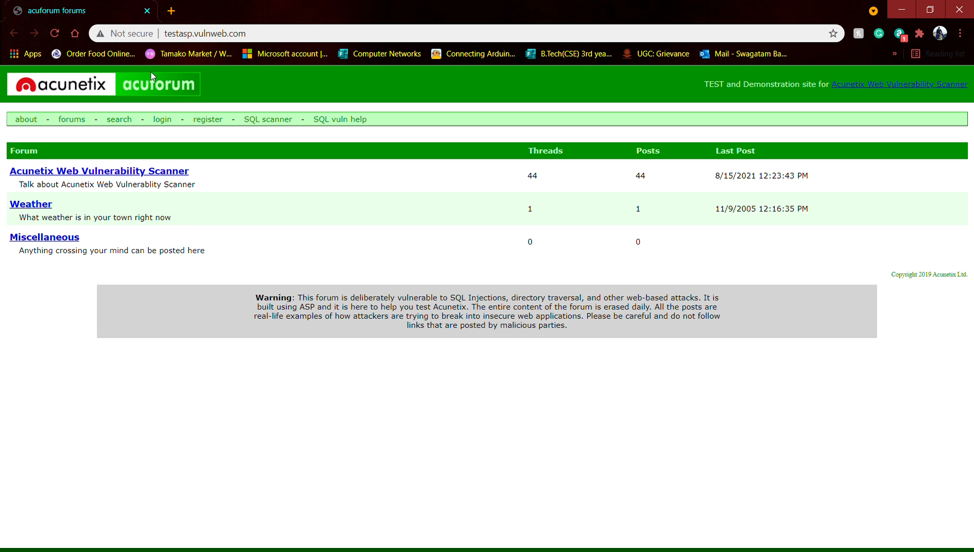
Proof of Concept (PoC)(video)-(Cross Site Scripting)

Slide 7
2. SQL Injection
SQL injection is a web security vulnerability that allows an attacker to interfere with the queries that an application makes to its database.
Cross-site Scripting (Important) | Impact It generally allows an attacker to view data that they are not normally able to retrieve. This might include data belonging to other users, or any other data that the application itself is able to access. In many cases, an attacker can modify or delete this data, causing persistent changes to the application's content or behavior. Remedy The only sure way to prevent SQL Injection attacks is input validation and parametrized queries including prepared statements.

Slide 8
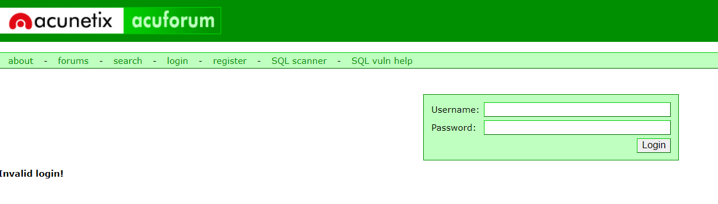
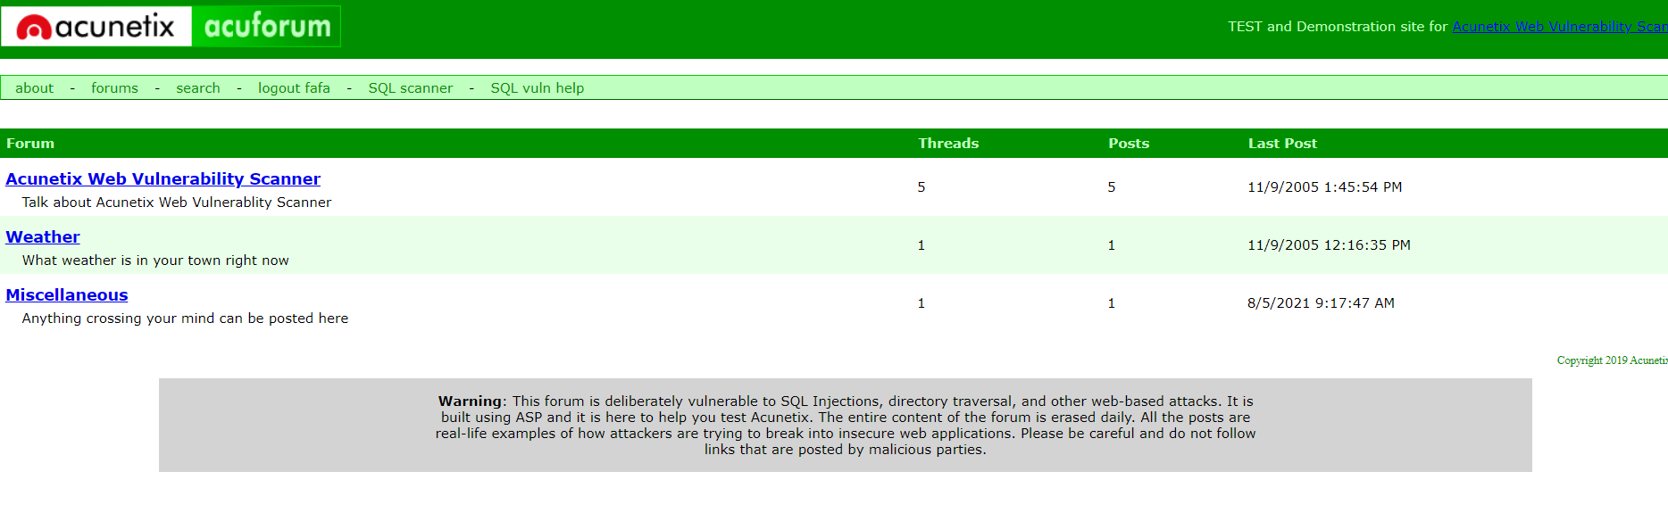
Proof of Concept (PoC)-(SQL Injection)
After entering invalid credentials for login
After SQL injection we can easily login without credentials

Slide 9

Proof of Concept (PoC)(video)-(SQL Injection)

Slide 10
THANK YOU

